Slide 1


Slide 2
Sons of God:
Serving the Father with intensity
Eph 2:8-10
14/01/18

Slide 3
Eph 2:8-10
⁸ For by grace you have been saved through faith, and that not of yourselves; it is the gift of God,
⁹ not of works, lest anyone should boast.
¹⁰ For we are His workmanship, created in Christ Jesus for good works,
which God prepared beforehand that we should walk in them.

Slide 4
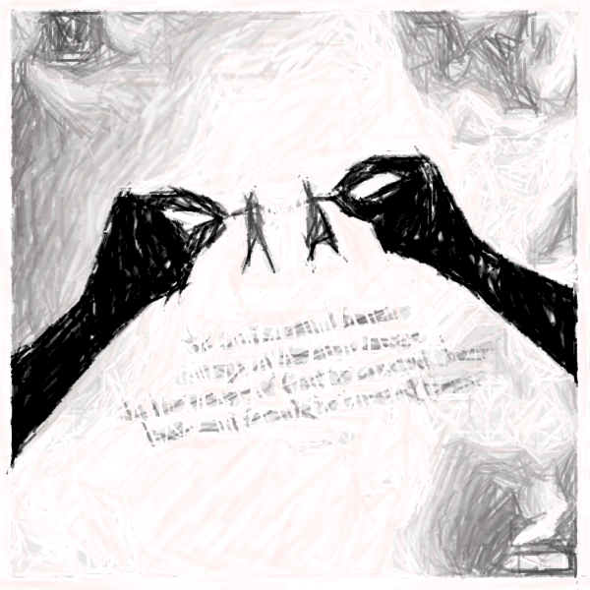
Gen 1:26-31 (Recap)
Created in the image and likeness of God
Created as a spirit being, with soul & body
Created to have a relationship with God
Created to serve God
Created to rule and reign with God

Slide 5
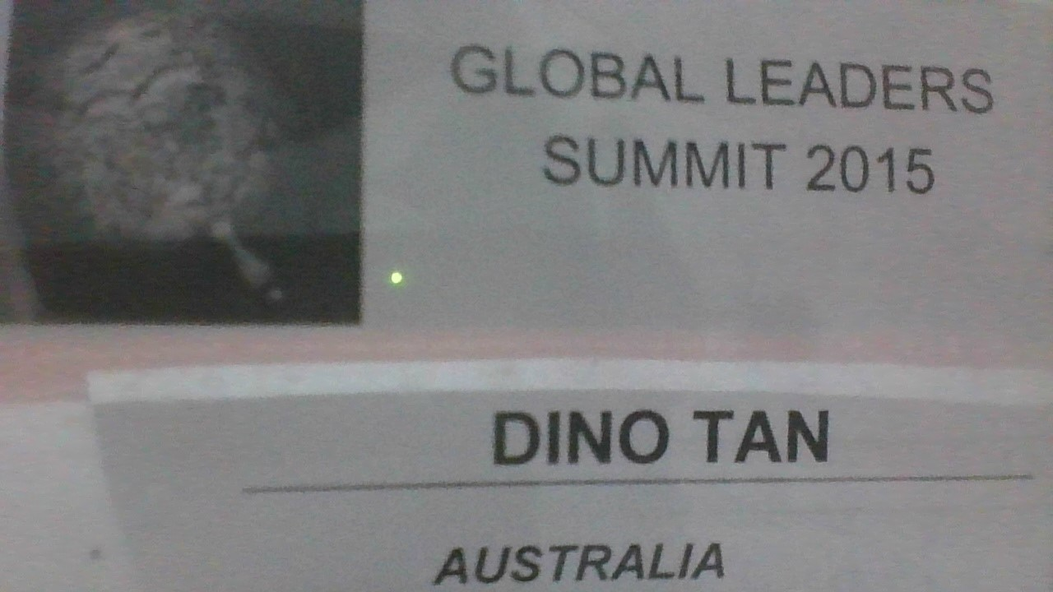

Slide 6
Serving God with intensity
1 Cor 9:16-27
“…preach the Gospel…”
“…made myself a servant…”
“…run in such a way…”
not uncertain, fight, discipline
Phil 3:12-14 – “…Press on!...”
2 Tim 2:1-7 – “…be strong…”
- Soldier, athlete, farmer

Slide 7
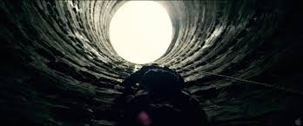

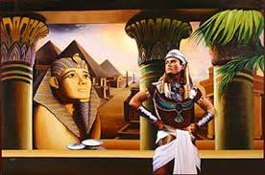
1) Determined
Make up our mind to run and win the crown to present to Him.
Antidote to “Discouragement”
Keep the faithfulness to God & do the right thing (e.g. Joseph)
“Whatever it takes, I will serve God”
PIT
PRISON
PALACE

Slide 8
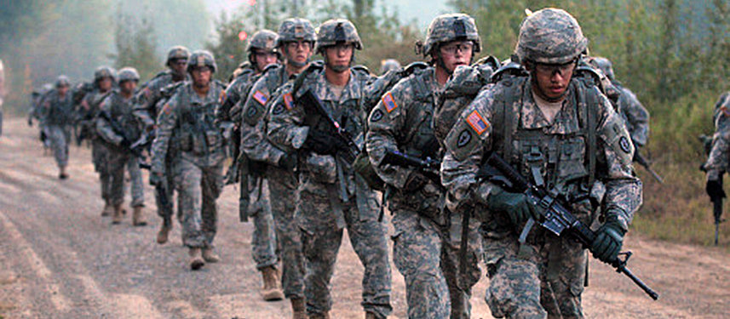
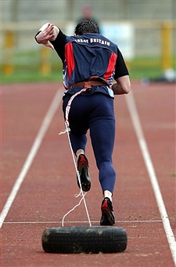

2) Disciplined
1 Tim 4:7 – Discipline and training
Antidote to “Distraction & laziness”
Rom 12:1-2,13:14, Ps 119:9-11 – not give in to the flesh. Keep ourselves pure
“I will stand for righteousness and truth!”

Slide 9

3) Distinguished
To stand out from the crowd and not flow with “normal” (Matt 7:13-14)
Antidote to “Indifferent = mediocre”
Gideon & 300 men:
The LORD told Gideon,
"With these 300 men
I will rescue you and
give you victory over
the Midianites. Send
all the others home.“
“Though none go with me I still will follow!”

Slide 10
Conclusion
The enemy will try to:
- Discourage
- Distract
- InDifferent (orDinary)
Guard our mind with the Word of God.
See the world as who we are not as it is.
We have a great DESTINY!

Slide 11
